Slide 1
Dytan: Control Flow Taint Analysis

Slide 2
Data Flow Taint Analysis
int a, b, w, x, y, z;
a = input();
b = input();
w = a * 2;
x = b + 1;
y = w + 1;
z = x + y;

Slide 3
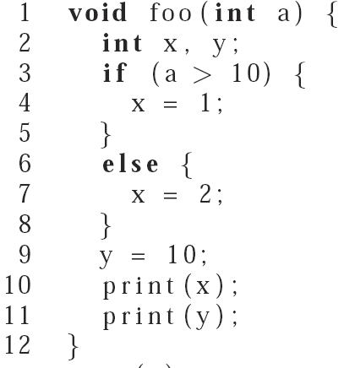
Challenge: Control Flow Taint Propagation

Slide 4
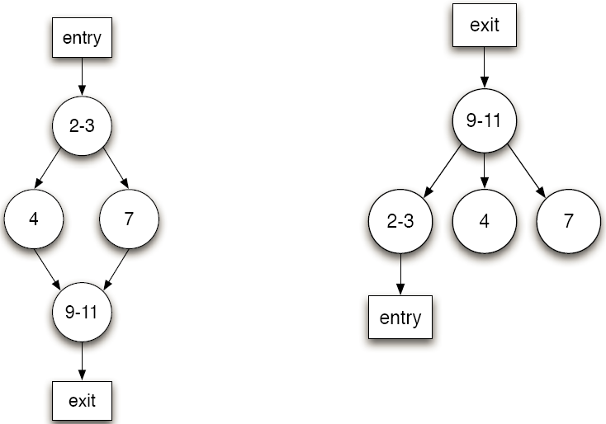
Dytan
Based on post-dominant tree

Slide 5
Taint Procedure
When the execution reaches a conditional branching statement br, our approach (1) computes a set taint that contains the combination of the taint markings for br’s source operands and (2) add to a set S a pair < br, taint >.
When the execution reaches ipdom(br), where br is a conditional branching statements, it removes from S all pairs < x, y > such that x is equal to br.
When a statement st is executed and S is not empty, it adds, for each pair < x, y > in S, the taint markings in y to the set of taint markings to be combined and associated to st’s destination operands.
Notes:
At foo’s entry, set S is empty. When line 3 is executed, our approach
would recognize this as a conditional branching statement
and add a pair < 7, {ta} > to S because ta is the (only) taint marking
associated with the branch’s source operands. The next line executed
is line 4. Because S is not empty, the taint markings in S are
combined and associated with the statement’s destination operands.
In this case, there is only one set in S, and the resulting set of markings
is {ta}, which gets associated with variable x. Next, line 9
is executed, which corresponds to ipdom(7). Pair < 7, {ta} > is
therefore removed from S, which becomes empty. At foo’s exit,
x’s set of taint markings is {ta}, which is the correct result.

